Slide 1


Slide 2

Lecture 9
Interpretation of Financial Statements & Incomplete Records

Slide 3
Learning Outcomes:
Upon successful completion of the session, students will be able to…
Describe how the interpretation & Analysis of financial statements is used in business context;
Explain the purpose of interpretation of Ratios;
Calculate key accounting ratios such as profitability, liquidity, efficiency and solvency;
Interpret the relationship between the elements of the financial statements with regard to profitability, liquidity, efficient use of resources and financial position;
Limitations of Financial Statement Analysis;
Understand and apply techniques used in incomplete record situations.

Slide 4
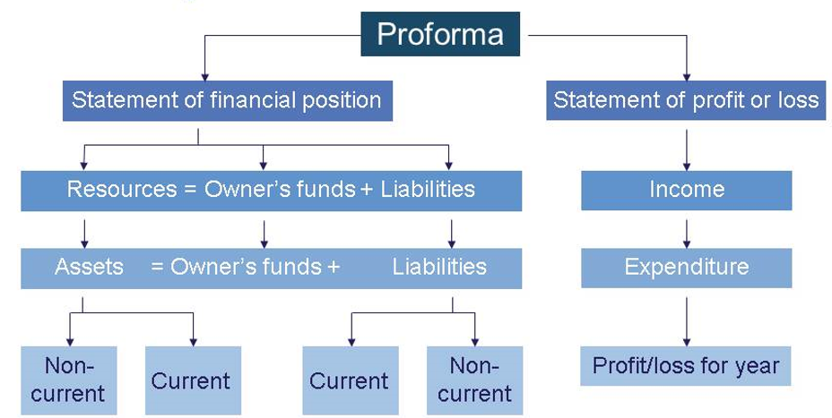

Slide 5

Financial Statement Analysis:
Interpreting the information presented in a business’s financial statements.
The results of this analysis should reveal more information about the business than just absolute numbers in the financial statements.

Slide 6
Who needs it and Why
User
Needs information for
CREDITORS | BORROWING AND CREDIT PURPOSES
1
EQUITY INVESTORS | INVESTMENT DECISIONS- BUYING AND SELLING SHARES
2
MANAGEMENT | CONTROL OF COSTS, IMPROVING PROFITABILITY
3

Slide 7
Objectives of FS Analysis
Although different investors demand different returns, they all use financial statement analysis for common reasons:
  To predict expected returns on their investments
  To assess the risks associated with those returns
Financial statement analysis focuses on past performance to predict future performance

Slide 8
How to Analyse FS?
Two major techniques:
Trend Analysis
Ratio Analysis

Slide 9

Trend Analysis
Trend analysis is a particular type of financial statement analysis where key financial figures are analyzed over time to see if there is a pattern of change.
Trend analysis can often be effectively illustrated through the use of graphs or charts.

Slide 10
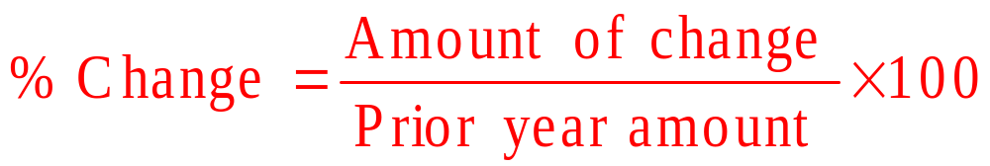
Trend Analysis in %
The dollar amount of the change is simply the current year minus the previous year.
The percentage change is computed as follows:

Slide 11
Trend Analysis
STELLAR CORPORATION
Income Statements
for the Years Ended December 31, 2015 and 2014
Increase % Increase
2015 2014 (Decrease) (Decrease)
Sales $98,600 $89,500 $9,100 10.2%
Expenses:
Wages expense 45,800 42,900 2,900 6.8%
Rent expense 12,000 12,000 0 0.0%
Utilities expense 6,500 6,450 50 0.8%
Depreciation expense 5,000 5,900 (900) (15.3%)
Total expenses 69,300 67,250 2,050 3.0%
Net Income $29,300 $22,250 $7,050 31.7%

Slide 12
Trend Analysis
Changes in dollar amounts and percentage terms help to expose patterns.
  Understanding these patterns is most important.
  The answers to why items changed tell a lot about how a company is run, how it will perform in the future, and whether or not it would be a good investment.
Analysts generally look at several years financial information in order to discover trends.

Slide 13
Ratio Analysis
Ratio analysis is a particular type of financial statement analysis where the relationship between two or more items from the financial statements is analyzed.
Some ratios might include information from various sources, including information not typically contained in the financial statements, such as market price of a stock.

Slide 14
Types of Ratios
Ratios can be grouped into the following categories:
  Profitability
  Efficiency / Activity
  Liquidity
  Solvency
  Investment/investor
Ratio analysis is about interpreting the significance of each ratio, not just calculating it. Calculated ratio on its own means nothing.

Slide 15
Profitability Ratios
Users want to know how much profit a business has made and just telling the absolute level of profit is not enough, it needs to be compared.
The profit also depends on the amount invested.
Profitability ratios indicate the firm’s overall effectiveness of operation

Slide 16
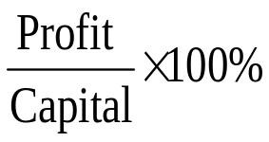

Profitability Ratios
Return on Capital Employed
  Known also as the Primary Ratio
  Measure of how well a company is at generating income against the total amount invested in the company

Slide 17
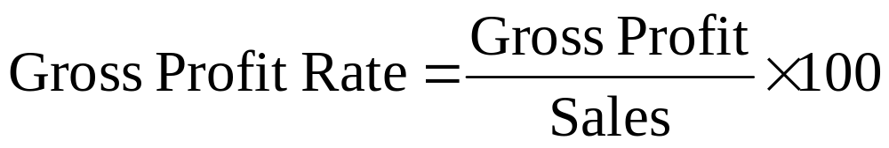

Profitability Ratios
2. Gross Profit and Net Profit Margin
  Changes in these percentages could indicate increases or decreases in costs or selling prices
  E.g. Is a company increasing sales by reducing selling prices?

Slide 18
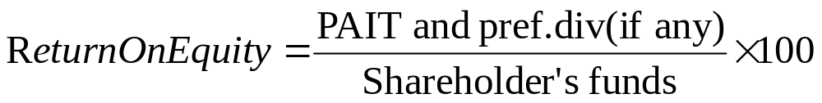
Profitability Ratios
3. Return on Equity/Return on Shareholders’ funds
  This focuses on the part of the profit that belongs to the shareholders. This profit is compared with the shareholder investment in the company (and the ratio could also be included under Investor ratios)
  Obviously an increase in this ratio will be a positive sign and could indicate increase of investment by the company or higher dividends

Slide 19
Efficiency Ratios
Measure the efficiency with which certain resources have been utilised within the business
Also known as activity ratios.
Efficiency can be measured on the basis of:
- Average age of a debt
- Average age of a credit
- Average length of time the company holds stock

Slide 20


Efficiency Ratios
Stock Turnover (in times)
or Days Stock in Inventory (Stock turnover period)
  The shorter the better. However, beware of running out of stock; potential shortages of supply; price increases.

Slide 21


Efficiency Ratios
3. Debtors Collection Period
The shorter the better. But careful - you don’t want to lose sales by being too strict.
4. Creditor Payment Period
  The longer the better but be careful! You don’t want to lose suppliers’ trust

Slide 22
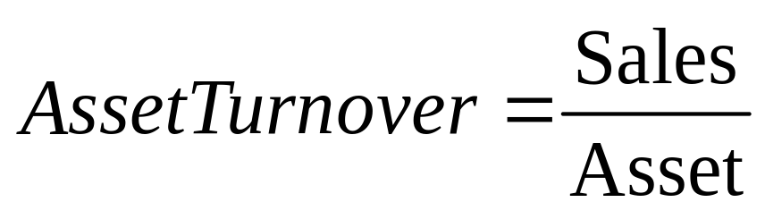
Efficiency Ratios
5. Asset Turnover
  May be Net Assets, Fixed Assets or Total Assets
  It aims to measure the ability of the investment in Assets to generate sales.

Slide 23
Liquidity Ratios
Liquidity refers to a company’s ability to generate the cash needed to meet its short-term obligations.
A liquid asset is one that can be easily converted into cash without significant loss of its original value

Slide 24


Liquidity Ratios
Current Ratio
Acid Test Ratio (Quick Ratio)

Slide 25
Liquidity Ratios
Different industries may have very different sized ratios and what is considered good in one might be considered dangerous in another.
Companies can only survive if they can pay their bills

Slide 26
Liquidity Ratios
Liquidity ratios can be improved by ensuring that:
Debtors settle their accounts as quickly as possible
(get money in)
Creditors are paid as late as possible (hold on money)
Reduce the amount of cash tied up in stock

Slide 27
Solvency Ratios
Solvency refers to a company’s ability to
meet its long-term financial obligations
Debt obligations include both paying back
the amount borrowed and paying interest
on the debt

Slide 28
Solvency Ratios
Total Debt to Equity Ratio (Gearing)
  In general, a high level of gearing (high debt) is more risky than a low level of gearing as interest is paid every year. Interest also reduces what’s available for shareholders

Slide 29

Solvency Ratios
2. Interest Cover
  Gives an idea of a company’s ability to pay total annual interest.

Slide 30
Investment Ratios
Ratios that are concerned with assessing the returns and performance of shares held in a particular business from the perspective of shareholders who are not involved with the management of the business

Slide 31
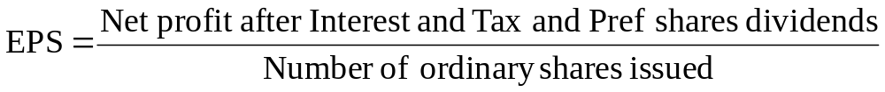
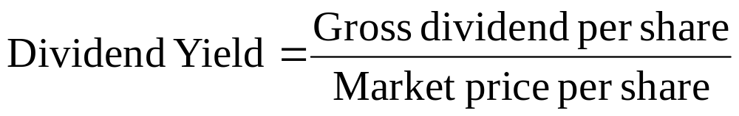
Investment Ratios
1. Earnings per share (EPS)
2. Dividend Yield
  how much a company pays out dividend each year relative to share price
  From investor point of view – how much cash flow investor gets for each dollar invested in an equity position

Slide 32

Investment Ratios
3. Dividend Cover
Gives an indication of a company’s dividend and reinvestment policy

Slide 33
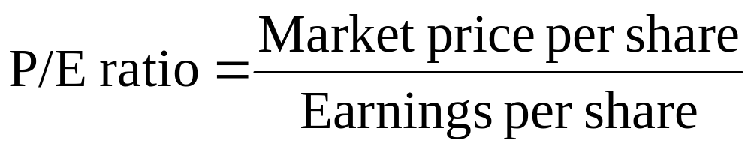
Investment Ratios
4. Price/Earning Ratio (short P/E ratio)
  Market price is x times the earnings (multiple of earnings)
  Shows how much investors are willing to pay per $ of earnings. For e.g. : if a company is trading at a (multiple) P/E of 20 – the investor is willing to pay $20 for $1 of current earnings.
  In general, a high P/E, investors expect higher earnings growth in the future

Slide 34
Evaluating Ratios
Ratios are evaluated using three types of comparisons.
  Time-series comparisons - comparisons of a company’s financial ratios with its own historical ratios
  Benchmarks - general rules of thumb specifying appropriate levels for financial ratios
  Cross-sectional comparisons - comparisons of a company’s financial ratios with the ratios of other companies or with industry averages

Slide 35
Limitations of Ratios
Attempting to predict the future using
past results depends on the predictive
value of the information used.
1
The financial statements used
to compute the ratios are
based on historical cost.
2
Figures used to calculate the
ratios are year-end numbers.
3

Slide 36
Limitations of Ratios
Industry peculiarities create difficulty
in comparing the ratios of a company
in one industry with those of a
company in another industry
4
Financial analysis may indicate that
something is wrong, but it may not
identify the specific problem or show
how to correct it.
5

Slide 37
Limitations of Ratios
Different accounting principles can
distort comparisons
6
It is difficult to generalize about whether a
particular ratio is “good” or “bad”
7
A firm might have some ratios that look
“good” and others that look “bad”, making
it difficult to tell whether the company is,
on balance, strong or weak
8

Slide 38
Incomplete Records
Incomplete records problems occur when a business does not have a full set of accounting records for one of the following reasons:
A trader does not maintain a ledger and therefore has no continuous double entry record of transactions.
Accounting records are destroyed by accident, such as fire.
Some essential figure is unknown and must be calculated as a balancing figure. This may occur as a result of inventory being damaged or destroyed, or because of misappropriation of assets.

Slide 39


Techniques

Slide 40
Accounting & Business Equation
Two equations are very useful in incomplete records calculations.
The accounting equation:
assets = capital + liabilities
The business equation:
closing net assets = opening net assets + capital introduced + profit – drawings

Slide 41
Bank and Cash
The approach to incomplete records questions is to build up the information given so as to complete the necessary double entry. This may involve reconstructing control accounts for:
Cash and bank
Trade receivables and payables

Slide 42
Credit sales and trade receivables
$
Payments from Trade Receivables X
Plus closing balance of trade receivables (since X
these represents sales in the current period for which
cash payment has not yet been received)
Less opening balance of trade receivables (these (X)
represents credit sales in a previous period)
Credit Sales in the Period X

Slide 43
Purchases and Trade Payables
$
Payments to trade payables during the period X
Plus: closing balance of trade payables (since these represent purchases in the current period for which payment has not yet been made) X
Less: opening balance of trade payables (these debts,
paid in the current period, relate to purchases in a previous period) (X)
Purchases during the period X

Slide 44
Mark-up & Margin
Where inventory, sales or purchases is the unknown figure, it will be necessary to use information on gross profit percentages to construct a working for gross profit in which the unknown figure can be inserted as a balance. While using following formula:
$
Opening Inventory X
Plus: Purchases X
Less: Closing Inventory (X)
Equal: Cost of Goods Sold X

Slide 45
Mark-up & Margin
Mark-up is the profit as a percentage of cost.
Gross profit margin is the profit as a percentage of sales.

Slide 46
Lecture Roundup:
Users of financial statements can gain a better understanding of the significance of the information in financial statements by comparing it with other relevant information.
Ratios such as profitability, liquidity, efficiency, solvency and investment ratios provide information through comparison.
It is important to interpret the relationship between the elements of the financial statements with regard to profitability, liquidity, efficient use of resources.
Ratio Analysis has limitations.
Using ledger total accounts, cash and/or bank summaries, gross profit percentage to calculate missing figures

Slide 47
References:
ACCA (2017) Approved Interactive Text. Foundations in Accountancy FFA 2017/2018. BPP Media Ltd, Chapter 17 & 26.
ACCA (2006) Approved text for the professional qualification, Study Text 2006/07, Paper 1. INT,Kaplan publishing: Foulks Lynch, chapter 23.
Besley, S & Brigham, F (2002) Essentials of Managerial Finance, 12th ed, chapter 3.
Woods, F. & Sangster, A. (2005) Business Accounting, 10th ed., chapter 47.
Dyson, J. (2004) Accounting for Non-accounting students, 6th ed., chapter 12.
Britton, A. & Waterson, C. (2003) Financial Accounting, Pearson Education Limited, third edition, chapters 9.
Horngren et al (2003) Introduction to Financial Accounting, 8/e
chapter 13.

